Slide 1




UNIVERSITY CLINIC TRACKER & VERIFIER
Ensuring Reliable Health Monitoring on Campus
T.Roopasri - 2410030033
Pranavi CR – 2410030233
Vishnuchethana - 2410030245
Swathi - 2410030248

Slide 2


Introduction
Students frequently misuse sickroom visits to avoid classes, creating administrative excuses during condonation reviews. Our secure system eliminates proxy attendance, provides transparent verification for faculty, and ensures accountability through real-time tracking. This streamlined approach reduces administrative burden while maintaining institutional integrity and fairness.

Slide 3

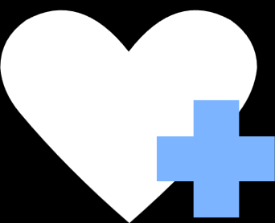

Objectives of the Project
To efficiently track student visits and treatments at the university clinic.
To verify medical records and ensure data accuracy.
To provide proof of attendance for students who visit the clinic, allowing them to show it to parents or faculty.
To streamline University management for staff and administration.
To improve overall healthcare monitoring on campus.

Slide 4
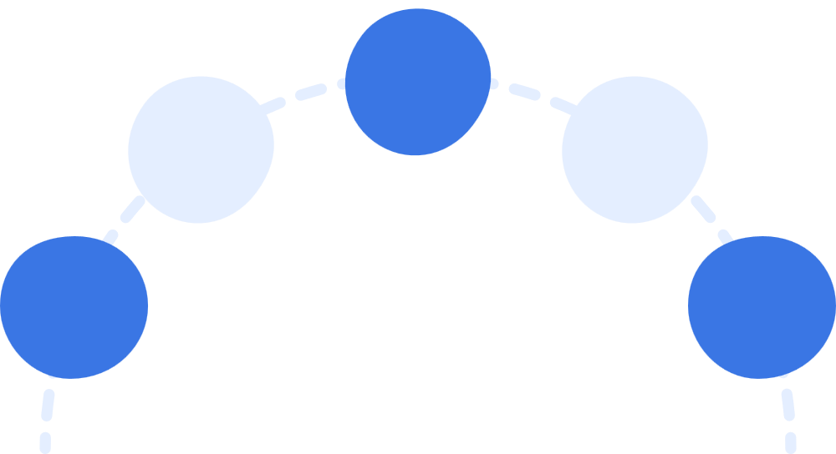
METHODOLOGY
Data Handling & Security
Module
Development
Analytics & Reporting
Requirement Analysis
& System Design
Testing & Validation

Slide 5

Requirement Analysis & System Design –
Identified the problem, set objectives, and designed a web-based system using HTML, CSS, and JavaScript.
Module Development –
Built modules for Clinic Staff (log visits), Students (view logs), and Faculty (verify and analyze).
Data Handling & Security–
Used local Storage to store visit logs with validation for correct and secure entries.
Analytics & Reporting –
Implemented charts for visit trends, frequent visitor detection, and options for printing/exporting logs.
Testing & Validation –
Verified each module, ensured accuracy of data, and tested system performance.

Slide 6

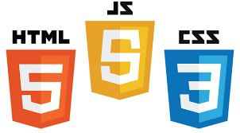
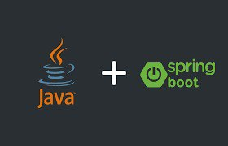
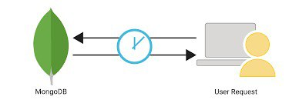
TOOLS WE USED IN OUR IMPLEMENTATION
HTML & CSS (Frontend):
The building blocks for structuring and styling web pages.
JavaScript (Frontend):
Adds interactivity and dynamic behavior to websites.
MongoDB (Dynamic Database):
A NoSQL database for storing and retrieving flexible, JSON-like data.
Java with Spring Boot:
A backend framework that simplifies building and deploying scalable Java applications.

Slide 7

Clinic Staff Flowchart
Student Details
Clinic Staff
log Visit
Entry Time
Exit Time
Generates QR Code
Update Exit Time

Slide 8

Student Flowchart
Student
My Visits
Input Of Student ID
Show Duration & Visits
Print My Logs

Slide 9
Faculty Flowchart
Faculty
Verify Student Visit
Input of Student ID
Show Charts (Bar Graph of Visit)
Download All Logs : CSV
Print All Logs
Print Student Log

Slide 10
Conclusion
The University Clinic Tracker & Verifier successfully digitalizes clinic record management by enabling staff to log visits, students to view their history, and faculty to verify records with analytics. The system ensures accurate data handling, secure storage, easy reporting, and improved efficiency compared to manual tracking.

Slide 11
Thankyou

